Slide 1
Graphical Abstract (GA)
A Graphical Abstract (GA) which provides a concise, visual summary of the findings of your article. The GA should be a figure or image from the accepted article. The ideal size for a GA is 660 x 295 (JPG format, < 45 KB). If you submitted a video with your article, the video will automatically become the GA and you will need to supply a still image to act as an overlay. The maximum file size for GA images is 45K. For an example of a GA, please click here.
Note: If your article did not have any images when it was peer reviewed, then you may include a figure that summarizes the main contributions of your article.

Slide 2
キャプション
Mean profiles of the six HEXACO personality dimensions across seven personality clusters identified in a large Japanese sample (N = 13,668). Each cluster represents a distinct configuration of traits, illustrating culturally grounded personality prototypes derived through multi-method clustering analysis.
38単語
カウンター
https://charactercalculator.com/ja/word-counter/

Slide 3
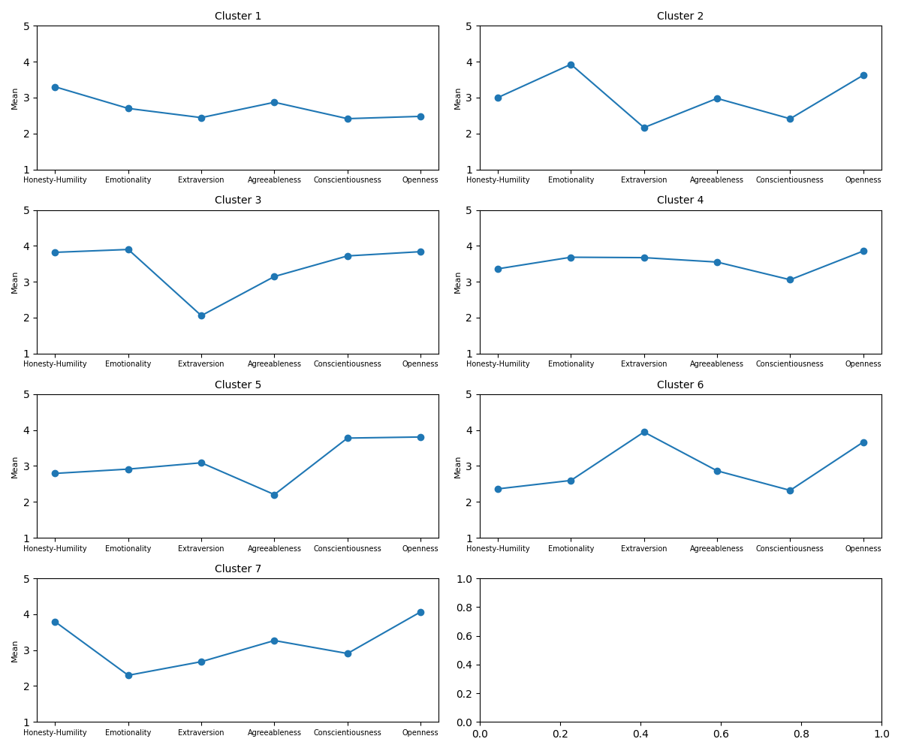

Slide 4
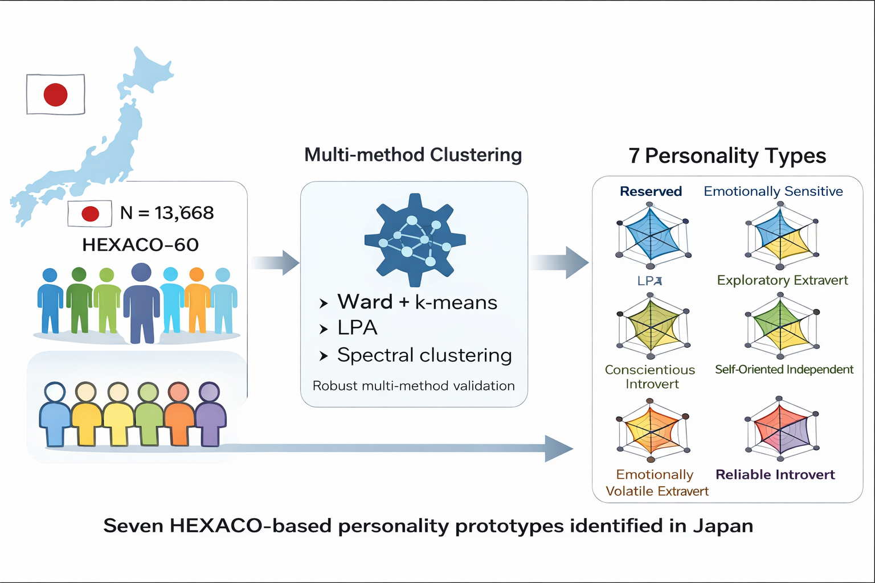
サンプル

Slide 5
